Slide 1
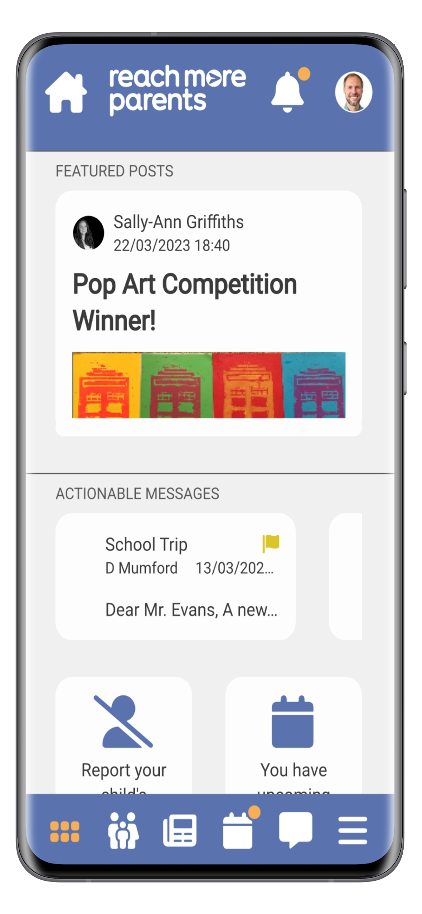

Slide 2
How to
Log in…
You will receive an email from Stockwell with welcome information about weduc.
There will be a blue link in the email. Please click the link.
Create a password
Reconfirm the password
Once logged in, please go to your app store (app store/play store) and download the ‘BJS FEDERATION APP’ (This is our own school app with the logo)
Login with the your email and the password you created.
Once logged in, have a browse.

Slide 3
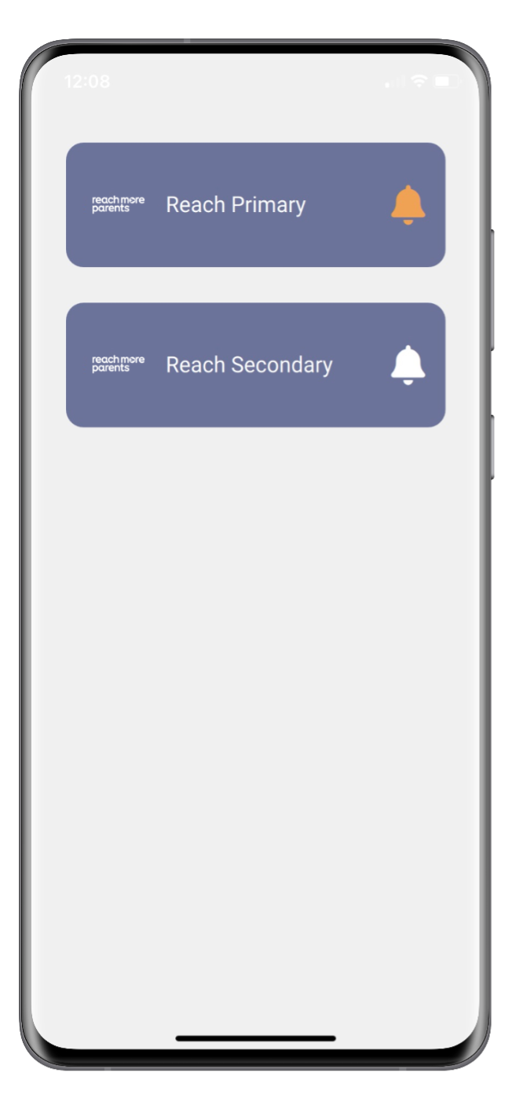
Navigation
School Selector
Parents can easily select between the different schools their children may be attending.
Upon opening the app, parents simply select which school they want to view information from.
Parents with children at only one school will bypass this and automatically see their own school.

Slide 4
Navigation
Bottom Navigation Bar
The bottom navigation bar contains the most common features used by parents.
There is also an additional hamburger navigation menu where less common features can be found.
Icons
Dashboard
Quick Access to Important Information
Parent Section
Information About Your Child
News Feed
News and Updates from School
Calendar
School events
Messages
Communications from School
Menu
Access to Additional Features

Slide 5
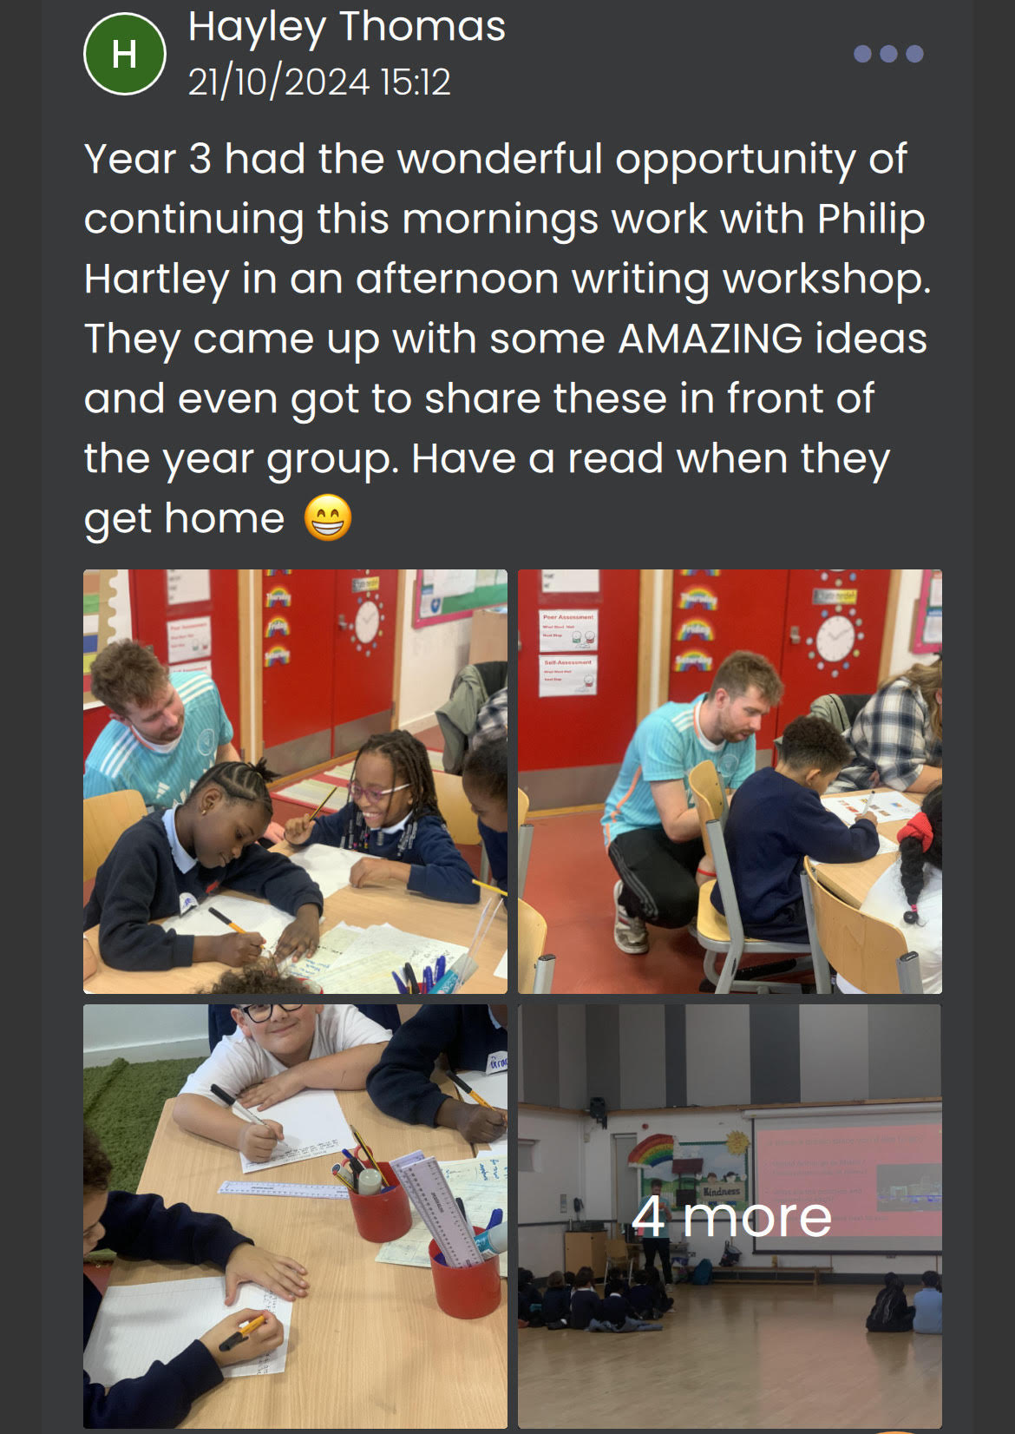
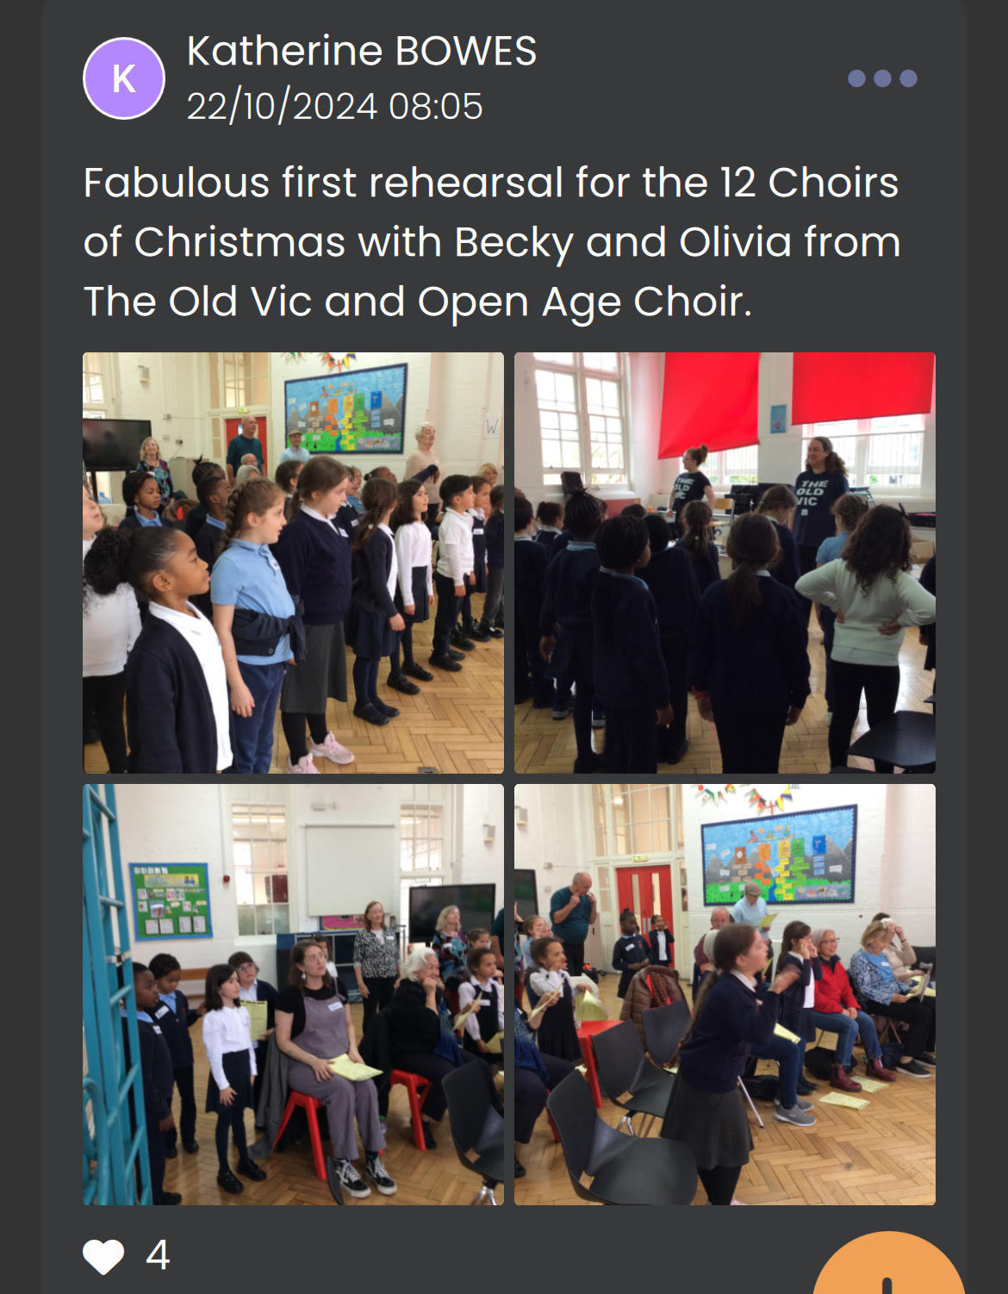
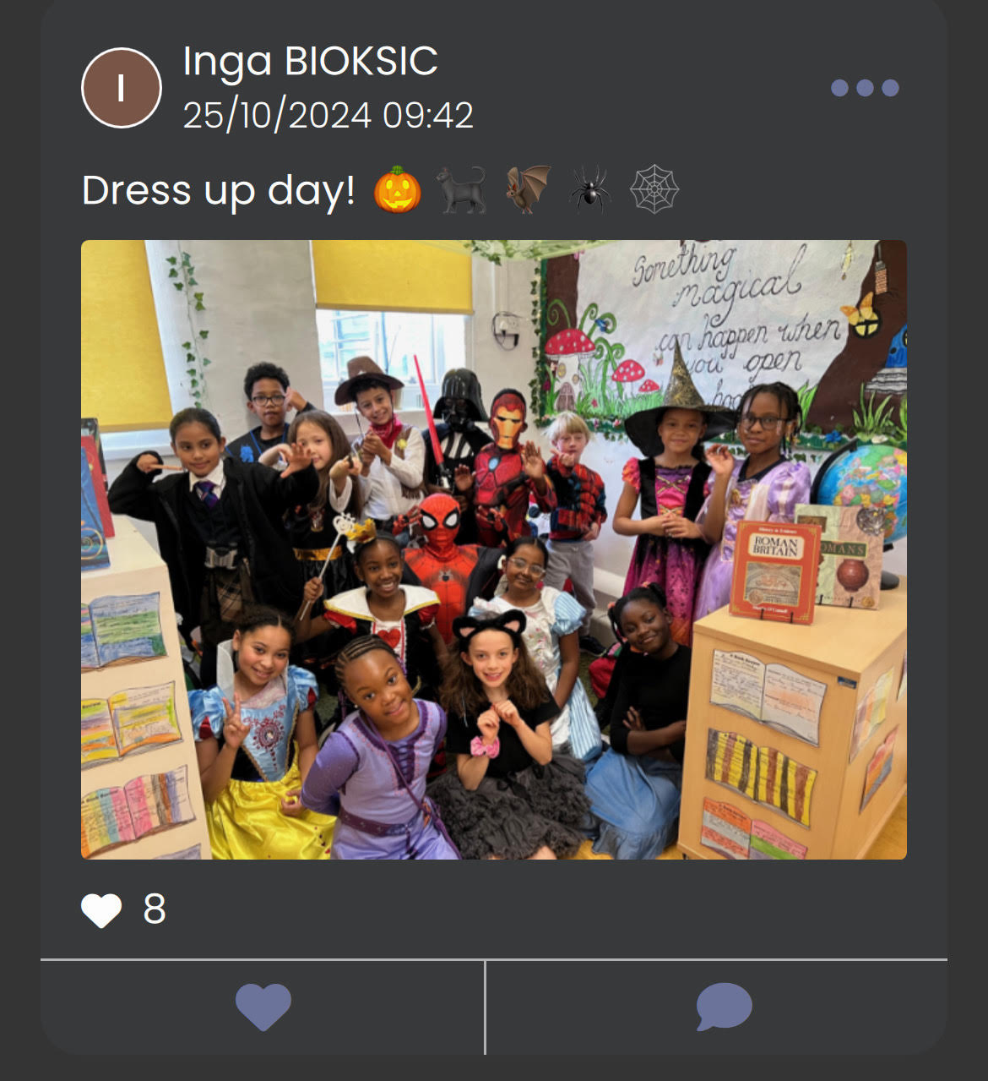
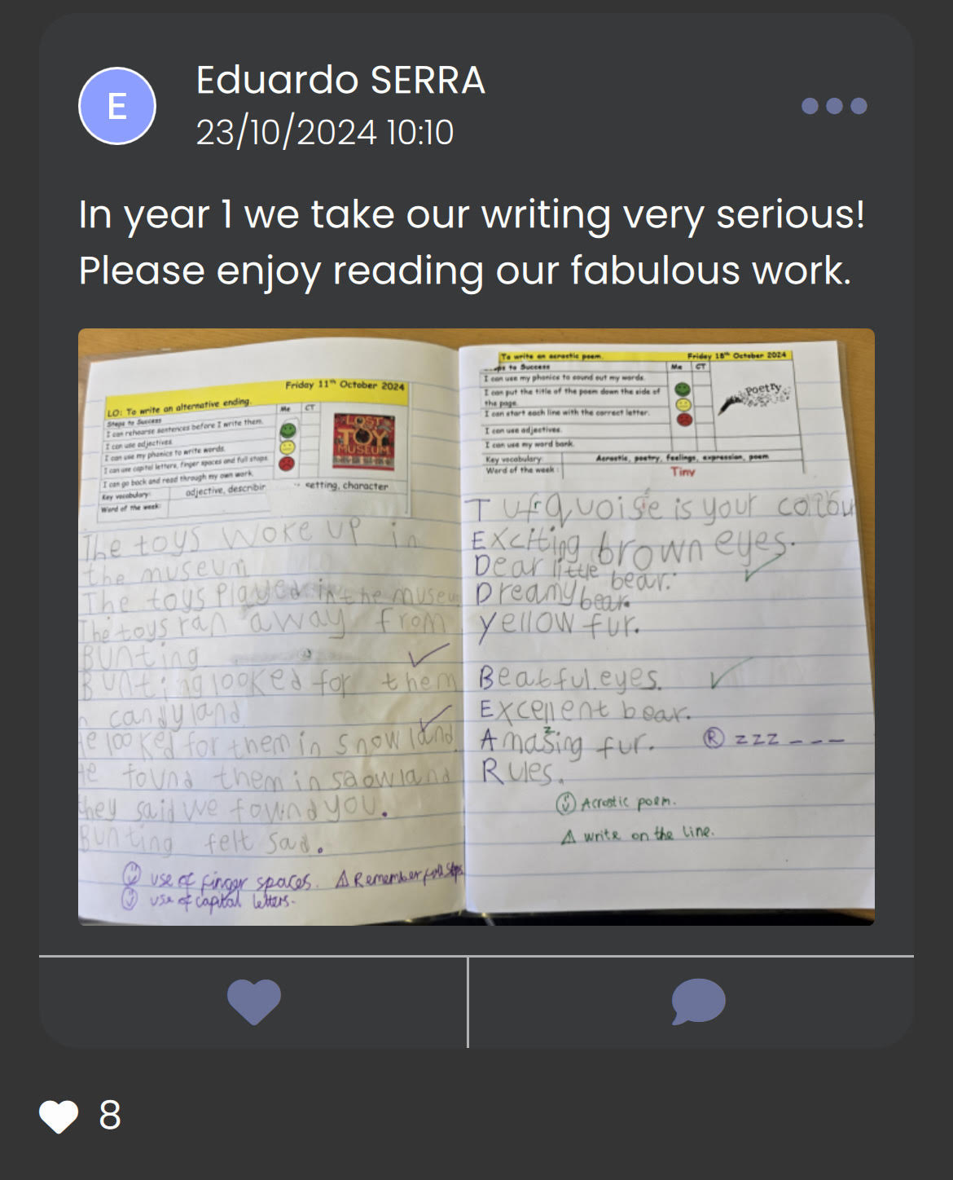
Features
Newsfeed
Parents can see ‘class happenings’ about their child’s class via a Social Media style newsfeed.

Slide 6
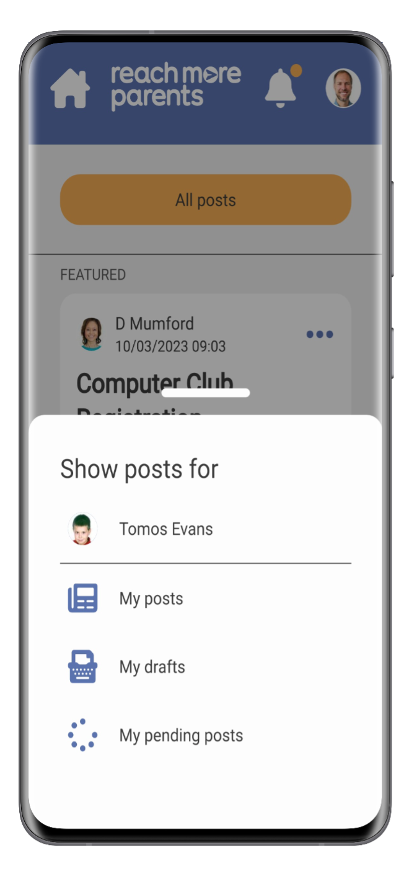
Features
Newsfeed
Parents who have more than one child at a school can filter their newsfeeds by child.

Slide 7
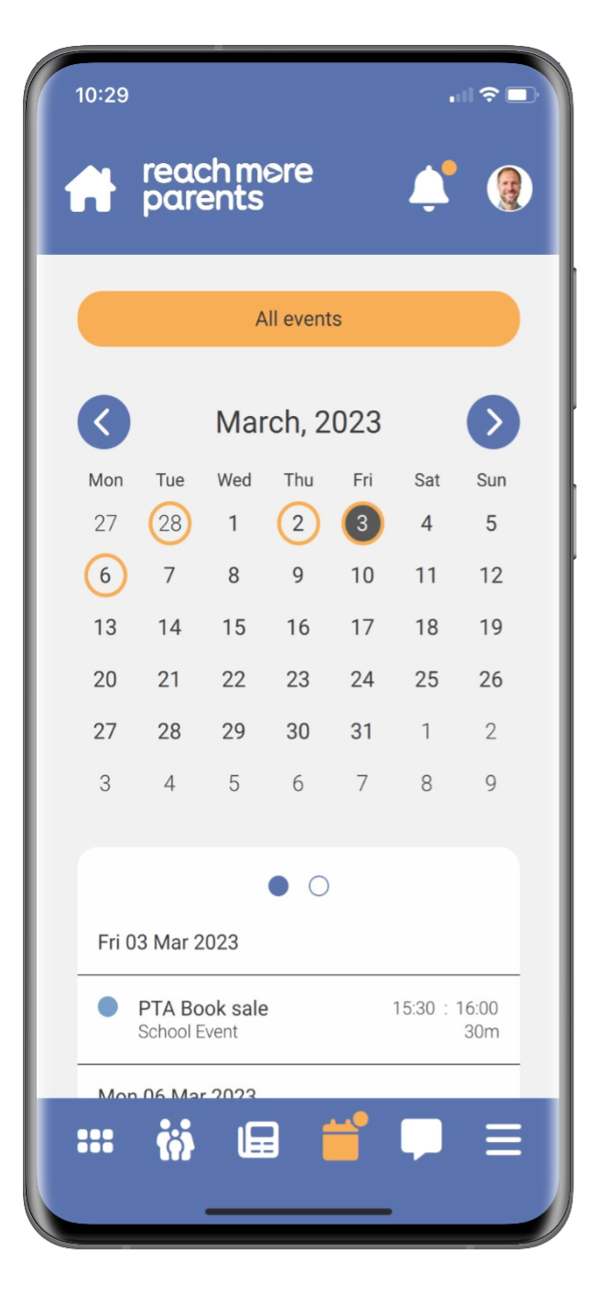
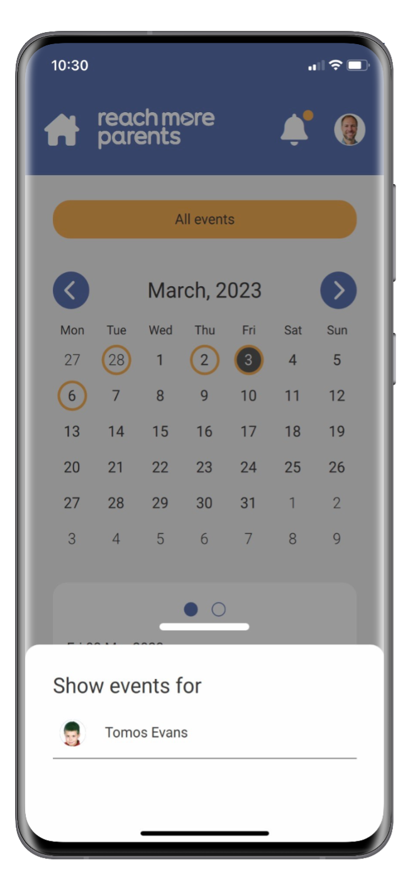
Features
Calendar
Like with the newsfeed filter, parents with children at more than one school can filter calendar events by individual child.

Slide 8
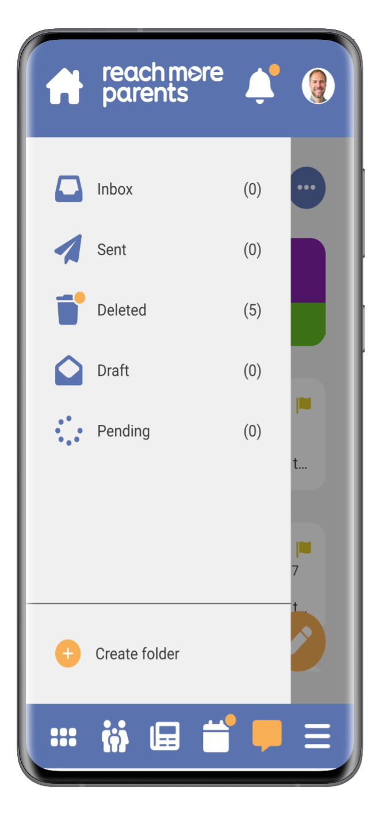
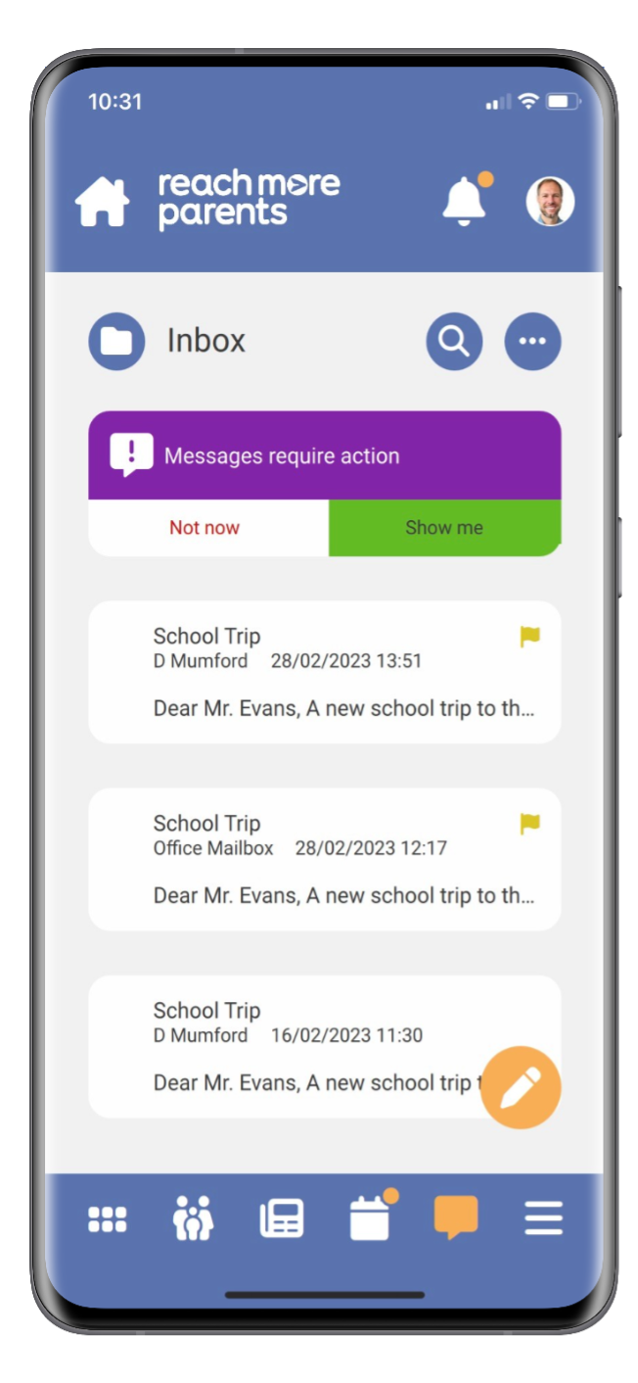
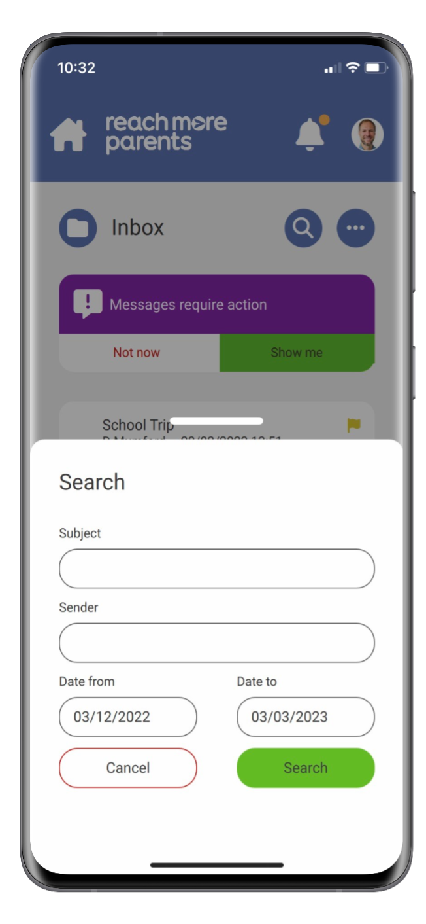
Features
Messages
Messages has a search facility, enabling parents to find key messages quickly.
They can also create additional folders to store messages in.
We will be using this feature this half term.

Slide 9
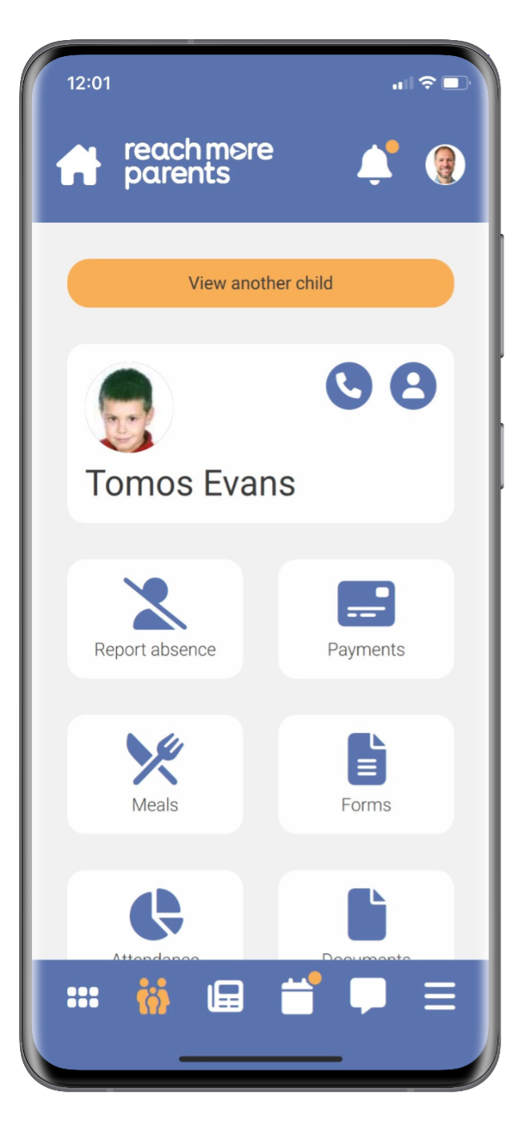
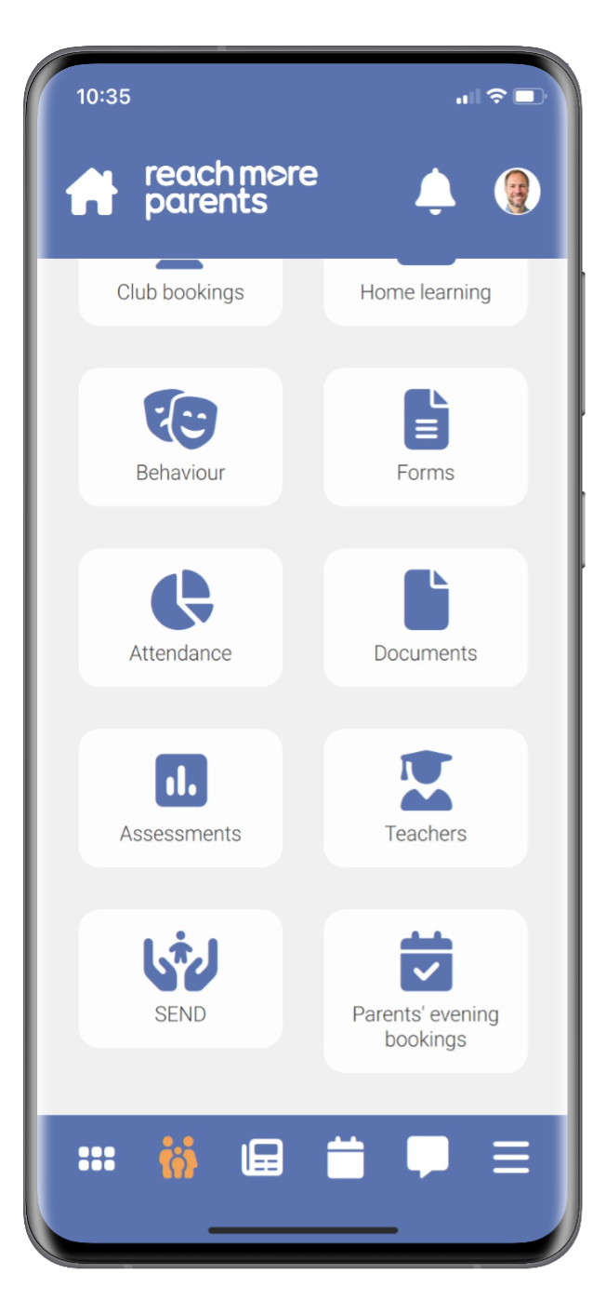
Features
Parent Portal
The Parent Portal enables parents to find child-specific items all in one place such as:
Payments
Forms
School Meals
Reporting Absence

Slide 10
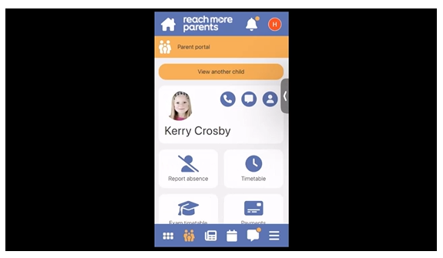
How to…
Parent Portal
Payments (2:00)
Bookings (4:26)

Slide 11
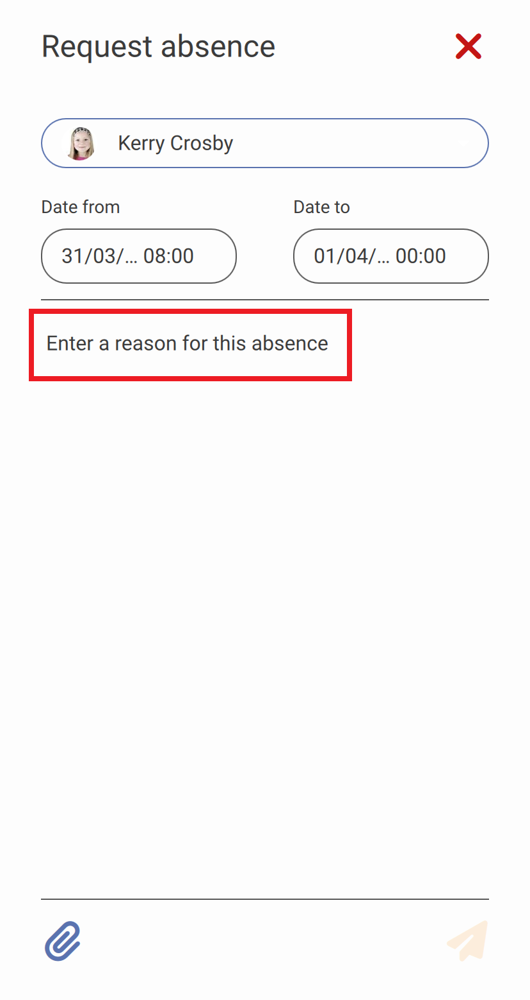
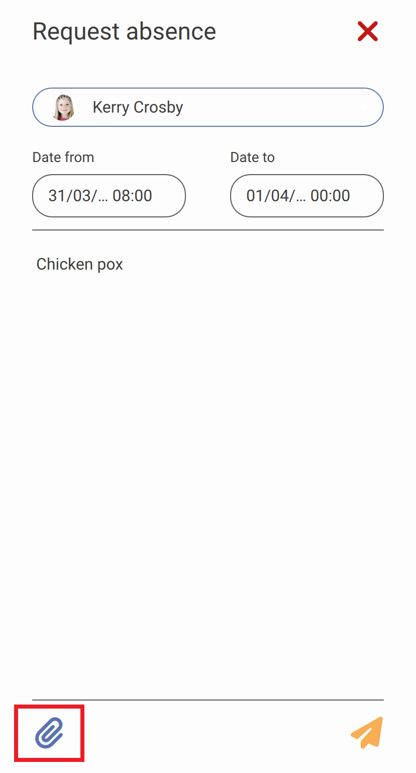
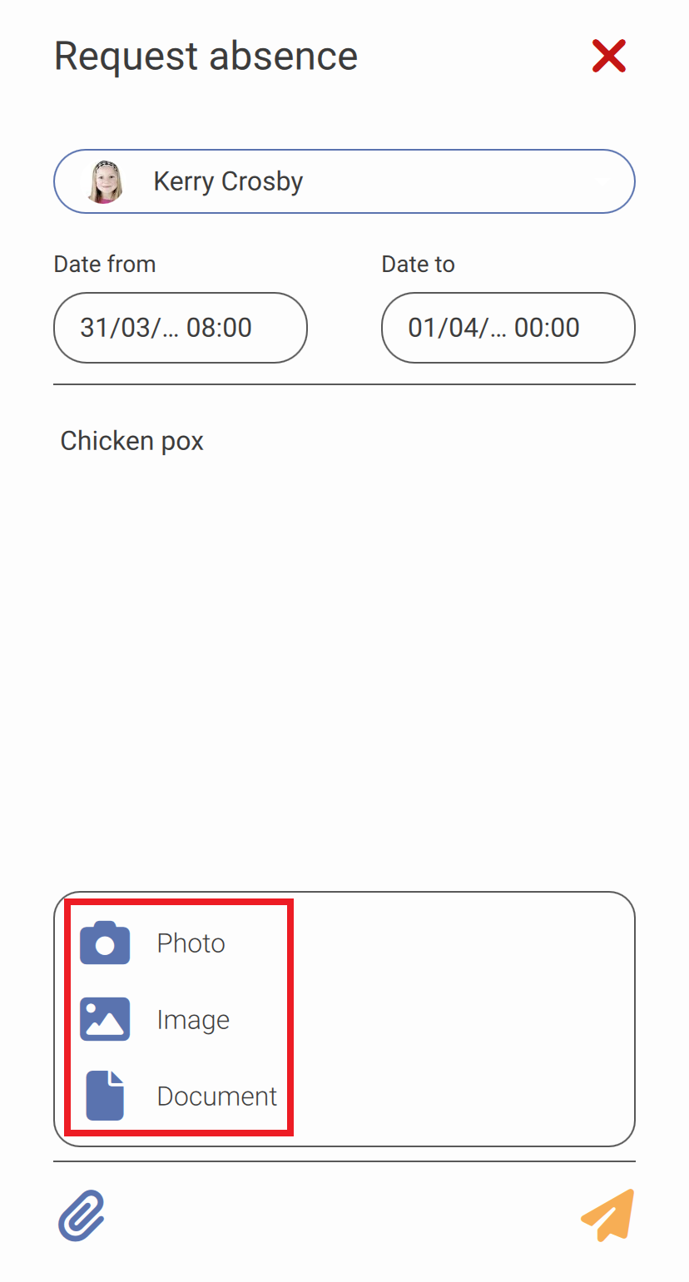
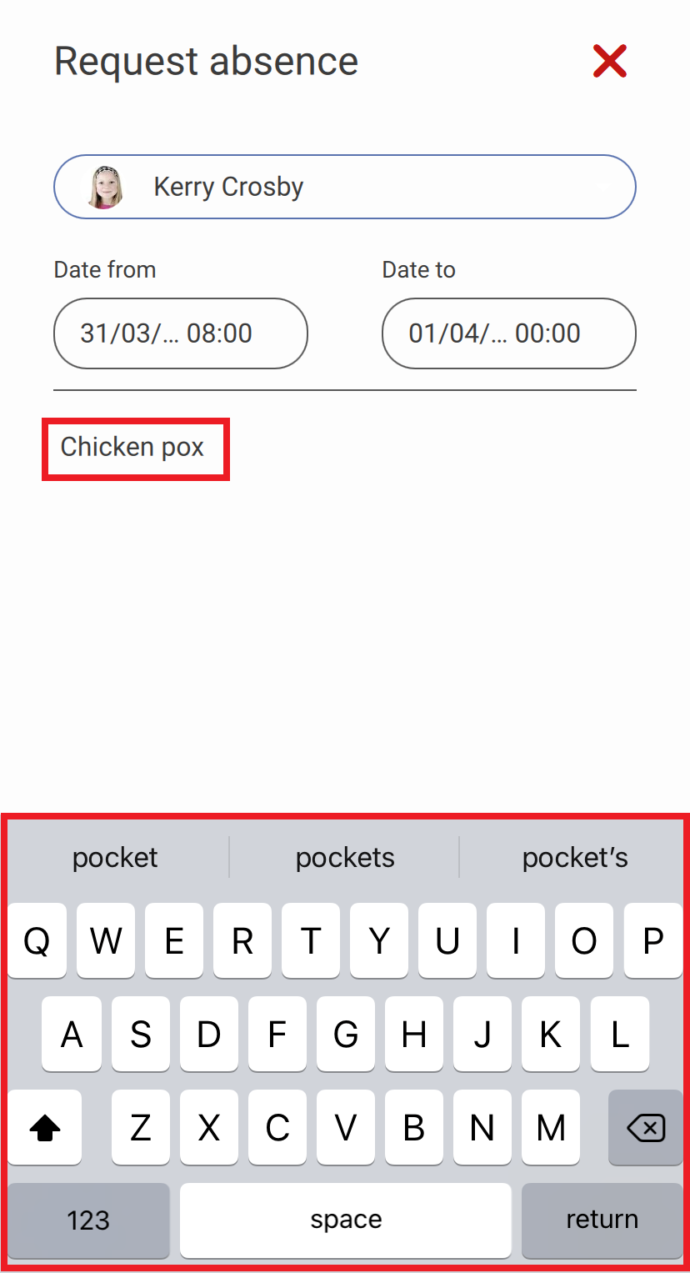
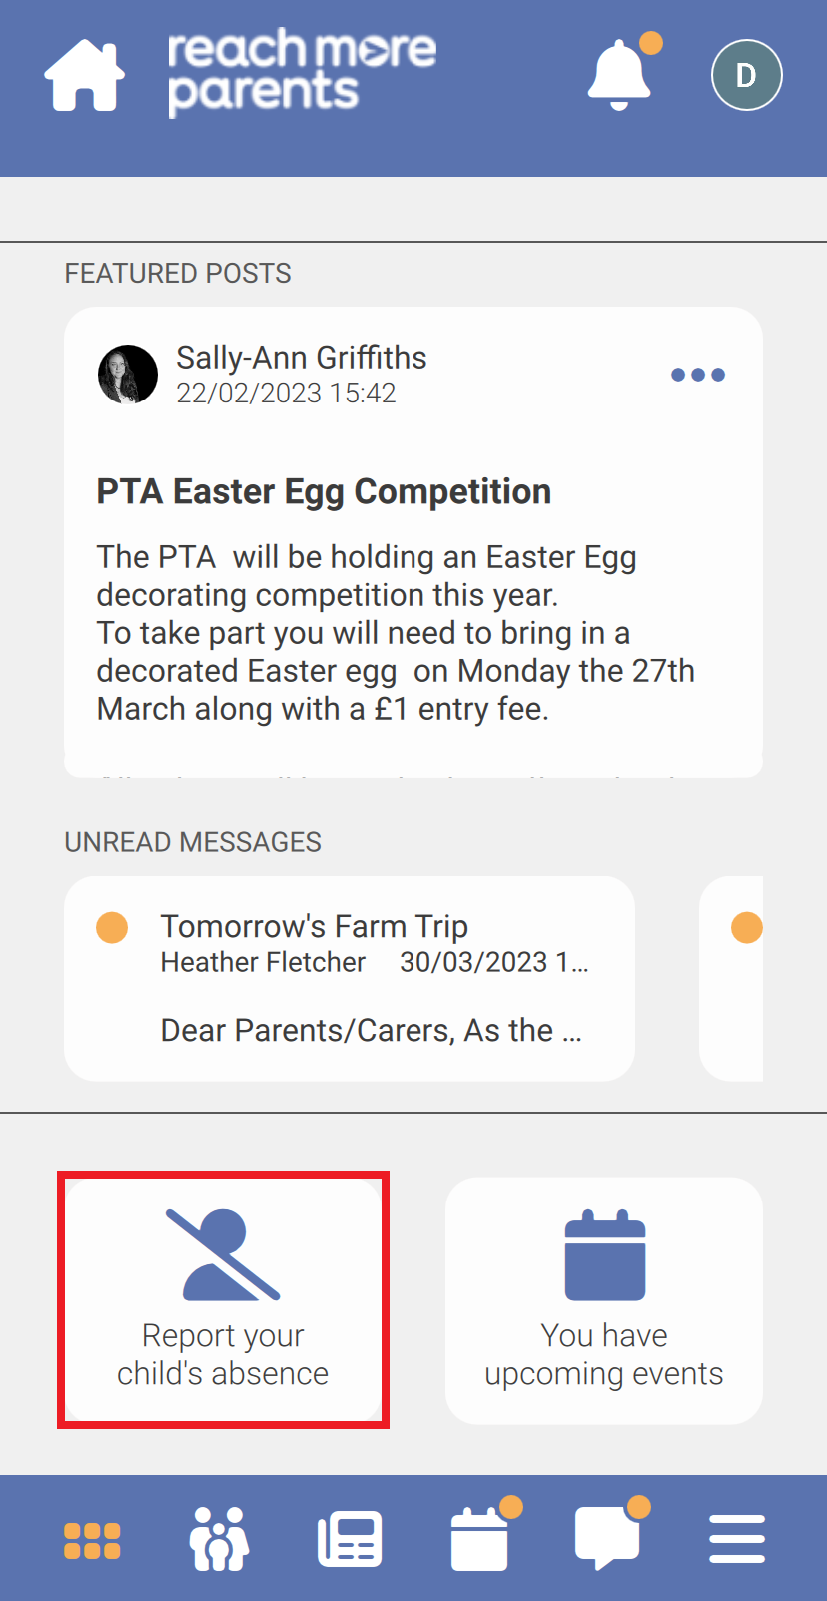
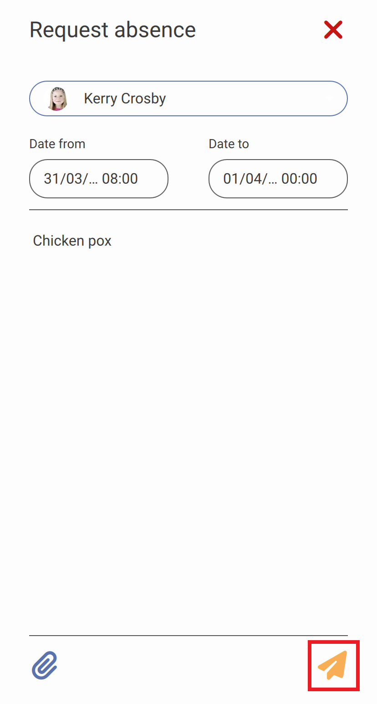
How to…
Report Absence
1) Log in to the app
2) Tap Report your child's absence
3) Enter the reason for your child's absence
4) Add an attachment if necessary. This can be used to attach a doctor's note.
5) Tap Send

Slide 12
Any questions?

